Slide 1
Civil Complaints
How to File a Civil Complaint in Court

Slide 2

How to File a Civil Complaint
To file civil complaints in Linn County, Oregon, you can:
View and download forms and instructions for use in Linn County Circuit Court.
Print any form for free and fill it out by hand, or purchase complete packets from the cashier at the Linn County courthouse or the Law Librarian at the Linn County Law Library.
Access Oregon court forms, including civil, criminal, probate, family law, and Tax Court.
Seek help understanding court forms from your local law librarian or the Circuit Court Clerk.

Slide 3
Filing Your Complaint
To file a complaint in Oregon, you generally start by identifying the appropriate agency or entity related to your issue, then file a formal complaint with them, often by completing a specific form online or via mail. For example, you can file complaints against businesses with the Oregon Department of Justice or the Better Business Bureau, while complaints related to financial institutions should be directed to the Oregon Division of Financial Regulation. A form for a civil complaint may be located on the Linn County Law Library’s website.
Here's a more detailed breakdown:
1. Identify the relevant agency or entity
2. Gather information and documentation
  Collect all relevant information about the problem, including dates, times, names of individuals involved, and specific details of the incident. Clearly state the facts of your case and the legal basis for your claim.
  Gather any documents that support your complaint, such as contracts, receipts, emails, or other relevant correspondence.
  Include your full name and address, the amount of damages you are seeking, and relevant dates.
  For Small Claims, you can use the "Small Claim and Notice of Small Claim" form, available on the Oregon Judicial Department website or at your county courthouse.
3. File your complaint at the courthouse: Many agencies have online complaint forms available on their websites. In some cases, you can
submit a written letter outlining your complaint.

Slide 4
Filing Your Complaint Continued …
Follow up:
Keep records: Make copies of everything you send and note the date you filed the complaint.
Be patient: Allow the agency time to investigate your complaint.
Respond to requests: If the agency requests additional information or documentation, respond promptly.
5. Consider Legal Options:
Small Claims Court: For certain types of disputes, you may be able to file a complaint in small claims court.
Legal Representation: If you have a complex legal issue or need assistance with the complaint process, consider consulting with an attorney.
By following these steps, you can effectively file a complaint and seek a resolution for your issue in Oregon.

Slide 5
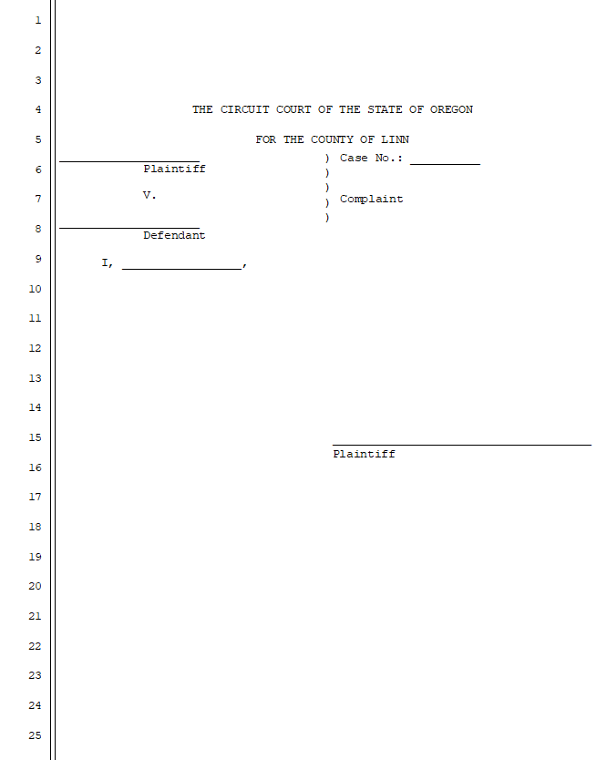
What Does a Complaint Form Look Like?

Slide 6
Format for a Complaint
You may use MS Word to create your complaint as a self-represented litigant (meaning you are representing yourself and not working with an Attorney). The format to be used includes the following:
  Alignment: Left
  Outline Level: Body Level
  Indentation Left: 0
  Indentation Right: 0
  Special: None
  Spacing Before and After: 0
  Line Spacing: Exactly
  Line Spacing At: 25.4 pt.
  To Add Numbers along the left-hand side of the document, go to Layout in MS Word, select line numbers, and then select continuous or start each page. NOTE: In a complaint, the numbers can be either continuous or discontinuous.

Slide 7
Additional Tools and Resources
You may find commonly used court forms at: https://www.linncountyor.gov/lawlibrary/page/legal-forms
For legal advice, you may want to seek the assistance of an Attorney or contact the Oregon
State Bar’s Lawyer Referral Service: https://www.osbar.org/public/ris/lrsform.html.
Oregon Law Help: Guide to Hiring a Lawyer in Oregon | Oregon Law Help
LASO: Legal Aid Services of Oregon - LASO

